Slide 1
Databases and Database Users
Dr. Ali Obaidi

Slide 2
Definition
A database is a collection of related data
example:
  1. collection of names, home address and telephone numbers
  2. collection of words to make paragraph in a page
A database represents some aspect of the real world, sometimes called the miniworld or the Universe of Discourse (UoD).
A database is a logically coherent collection of data with some inherent meaning. A random assortment of data cannot correctly be referred to as a database.
Notes:
Data: known facts that can be recorded and has implicit meaning.

Slide 3
Definition ….
A database is designed, built, and populated with data for a specific purpose. It has an intended group of users and some preconceived applications in which these users are interested.
A database can be of any size and of varying complexity
A database may be generated and maintained manually or it may be computerized (set of application programs or by RDBM).
Notes:
A database has some source from which data is derived. Some degree of interaction with event in the real world and an audience that is actively interested in the content of the db.
Example: address book, library catalog and IRS.

Slide 4
Database Management System
Is a collection of programs that enables users to create and maintain a database.
The DBMS is a general-purpose software system that facilitates the processes of defining, constructing, and manipulating databases for various applications
Defining: a database involves specifying the data types, structures, and constraints for the data to be stored in the database.

Slide 5
DBMS …..
Constructing: the database is the process of storing the data itself on some storage medium that is controlled by the DBMS.
Manipulating: a database includes such functions as querying the database to retrieve specific data, updating the database to reflect changes in the miniworld, and generating reports from the data.
We will call the database and DBMS software together a database system

Slide 6
Example
UNIVERSITY database for maintaining information concerning students, courses, and grades in a university environment
define: file (records), data elements, data type ( for each data element)
construct: store data in the appropriate files (note that records may be related between files)
Manipulation: querying, updating
  informal queries and updates must be specified precisely in the database system language before they can be processed.

Slide 7
DB Vs Programming with files
Self-Describing Nature of a Database System
  single repository of data is maintained
  contains not only the database itself but also a complete definition or description of the database structure and constraints (system catalogue).
  information stored in the catalog is called meta-data
  catalog used by the DBMS and users.
  The DBMS software work equally well with any number of database applications.

Slide 8
DB Vs Programming with files …..
Insulation between Programs and Data, and Data Abstraction
  program-data independence
  The characteristic that allows program-data independence and program-operation independence is called data abstraction
  A DBMS provides users with a conceptual representation of data that does not include many of the details of how the data is stored or how the operations are implemented. (data model )
  data model hides storage and implementation details that are not of interest to most database users.
  in object-oriented and object-relational databases, abstraction is carried one level further to include not only the data structure but also the operations on the data

Slide 9
Database Actors
Database Administrators
  In a database environment, the primary resource is the database itself and the secondary resource is the DBMS and related software
  authorizing access to the database
  coordinating and monitoring its use
  acquiring software and hardware resources as needed
Database Designers
  identifying the data to be stored in the database
  choosing appropriate structures to represent and store this data undertaken before the database is actually implemented and populated with data

Slide 10
Database Actors …..
  communicate with all prospective database users, in order to understand their requirements
  develop a view of the database that meets the data and processing requirements for each group of users
  These views are then analyzed and integrated with the views of other user groups. The final database design must be capable of supporting the requirements of all user groups
End Users
  access to the database for querying, updating, and generating reports
  Casual end users:
  occasionally access the database
  need different information each time
  learn only a few facilities that they may use repeatedly.

Slide 11
Database Actors …..
  use a sophisticated database query language to specify their requests
  typically middle- or high-level managers or other occasional browsers
Naive or parametric end users
  constantly querying and updating the database, using standard types of queries and updates called canned transactions that have been carefully programmed and tested
  need to learn very little about the facilities provided by the DBMS
  Bank tellers check account balances and post withdrawals and deposits
  Reservation clerks for airlines, hotels, and car rental companies check availability for a given request and make reservations
  Clerks at receiving stations for courier mail enter package identifications via bar codes and descriptive information through buttons to update a central database of received and in-transit packages

Slide 12
Database Actors …..
Sophisticated end users
  Engineers, scientists, business analysts, and others who thoroughly familiarize themselves with the facilities of the DBMS so as to implement their applications to meet their complex requirements
  Try to learn most of the DBMS facilities in order to achieve their complex requirements
Stand-alone users
  Maintain personal databases by using ready-made program packages that provide easy-to-use menu- or graphics-based interfaces. An example is the user of a tax package that stores a variety of personal financial data for tax purposes
  Typically become very proficient in using a specific software package

Slide 13
Database Actors …..
System Analysts and Application Programmers
  Determine the requirements of end users, especially naive and parametric end users, and develop specifications for canned transactions that meet these requirements
  Application programmers implement these specifications as programs; then they test, debug, document, and maintain these canned transactions
Workers behind the Scene
  Typically do not use the database for their own purposes
  DBMS system designers and implementers
  design and implement the DBMS modules (for implementing the catalog, query language, interface processors, data access, concurrency control, recovery, and security. ) and interfaces as a software package

Slide 14
Database Actors …..
Tool developers
  Tools are optional packages that are often purchased separately
  include packages for database design, performance monitoring, natural language or graphical interfaces, prototyping, simulation, and test data generation.
Operators and maintenance personnel
  system administration personnel who are responsible for the actual running and maintenance of the hardware and software environment for the database system

Slide 15
Advantages of Using DBMS
Controlling Redundancy
  Problems:
  there is the need to perform a single logical update (duplication of effort)
  storage space is wasted when the same data is stored repeatedly files that represent the same data may become inconsistent(typos)
  in DBMS there has the ability to control redundancy which improve the performance of the query.
  the DBMS should have the capability to control this redundancy so as to prohibit inconsistencies among the files

Slide 16
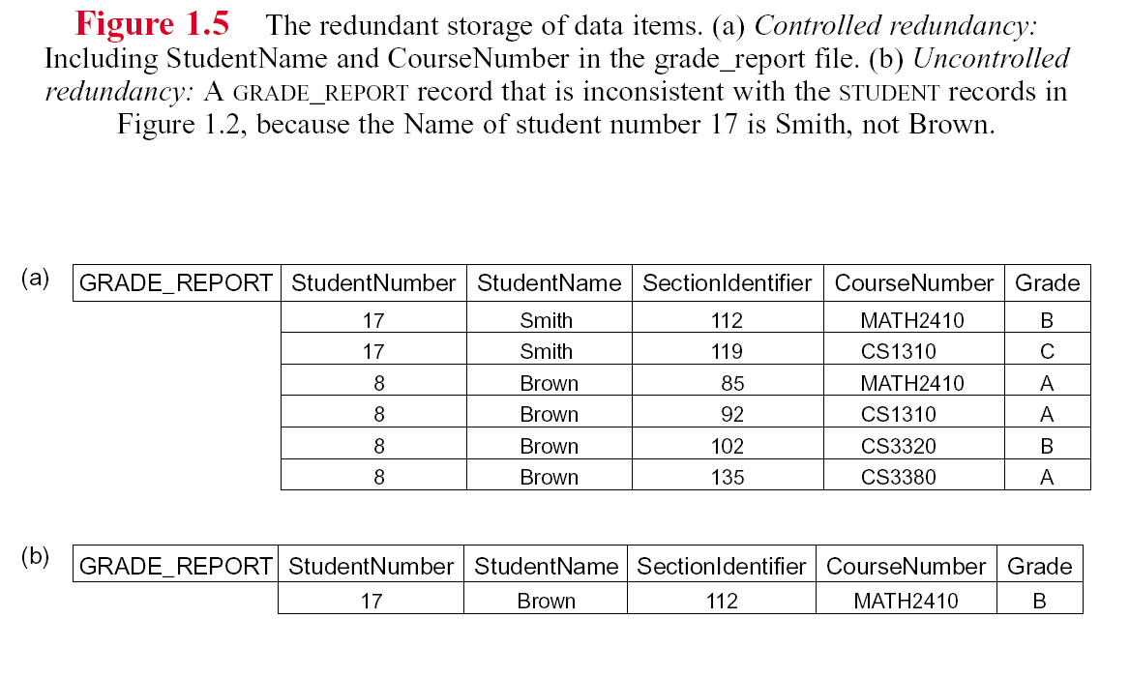

Slide 17
Advantages of Using DBMS …..
Restricting Unauthorized Access
  users or user groups are given account numbers protected by passwords, which they can use to gain access to the database through security and authorization subsystem
Providing Persistent Storage for Program Objects and Data Structures
  Programming languages typically have complex data structures, such as record types in PASCAL or class definitions in C++. The values of program variables are discarded once a program terminates, unless the programmer explicitly stores them in permanent files, which often involves converting these complex structures into a format suitable for file storage

Slide 18
Advantages of Using DBMS …..
  When the need arises to read this data once more, the programmer must convert from the file format to the program variable structure.
  Object-oriented database systems are compatible with programming languages such as C++ and JAVA, and the DBMS software automatically performs any necessary conversions
  impedance mismatch problem:the data structures provided by the DBMS were incompatible with the programming language’s data structures.
Permitting Inferencing and Actions Using Rules

Slide 19
Advantages of Using DBMS …..
  deductive database systems:when database systems provide capabilities for defining deduction rules for Inferencing new information from the stored database facts
  there may be complex rules in the miniworld application for determining when a student is on probation. (rules)
  traditional DBMS, an explicit procedural program code would have to be written to support such applications
Providing Multiple User Interfaces
  a DBMS provides a variety of user interfaces:query languages for casual users; programming language interfaces for application programmers; forms and command codes for parametric users; and menu-driven interfaces and natural language interfaces for stand-alone users.
  Capabilities for providing World Wide Web access to a database

Slide 20
Advantages of Using DBMS …..
Representing Complex Relationships Among Data
Enforcing Integrity Constraints
  The simplest type involves specifying a data type for each data item
  A more complex type involves specifying that a record in one file must be related to records in other files.
  Another type specifies uniqueness on data item values
  It is the database designers’ responsibility to identify integrity constraints during database design.
Providing Backup and Recovery
provide facilities for recovering from hardware or software failures.(The backup and recovery subsystem )

Slide 21
Implications of the Database Approach
Potential for Enforcing Standards
  defined for names and formats of data elements, display formats, report structures, terminology, etc..
Reduced Application Development Time
  A prime selling feature of the database approach is that developing a new application such as the retrieval of certain data from the database for printing a new report takes very little time
  Development time using a DBMS is estimated to be one-sixth to one-fourth of that for a traditional file system.
Flexibility
  It may be necessary to change the structure of a database as requirements change

Slide 22
Implications of the Database Approach…..
Availability of Up-to-Date Information
Economies of Scale
  The DBMS approach permits consolidation of data and applications, thus reducing the amount of wasteful overlap between activities of data-processing personnel in different projects or departments.

Slide 23
When Not to Use a DBMS
overhead costs :
  High initial investment in hardware, software, and training.
  Generality that a DBMS provides for defining and processing data.
  Overhead for providing security, concurrency control, recovery, and integrity functions.
  if the database designers and DBA do not properly design the database
  if database systems applications are not implemented properly
  use regular files under the following circumstances:
    The database and applications are simple, well defined, and not expected to change.
    There are stringent real-time requirements for some programs that may not be met because of DBMS overhead.
    Multiple-user access to data is not required

Slide 24
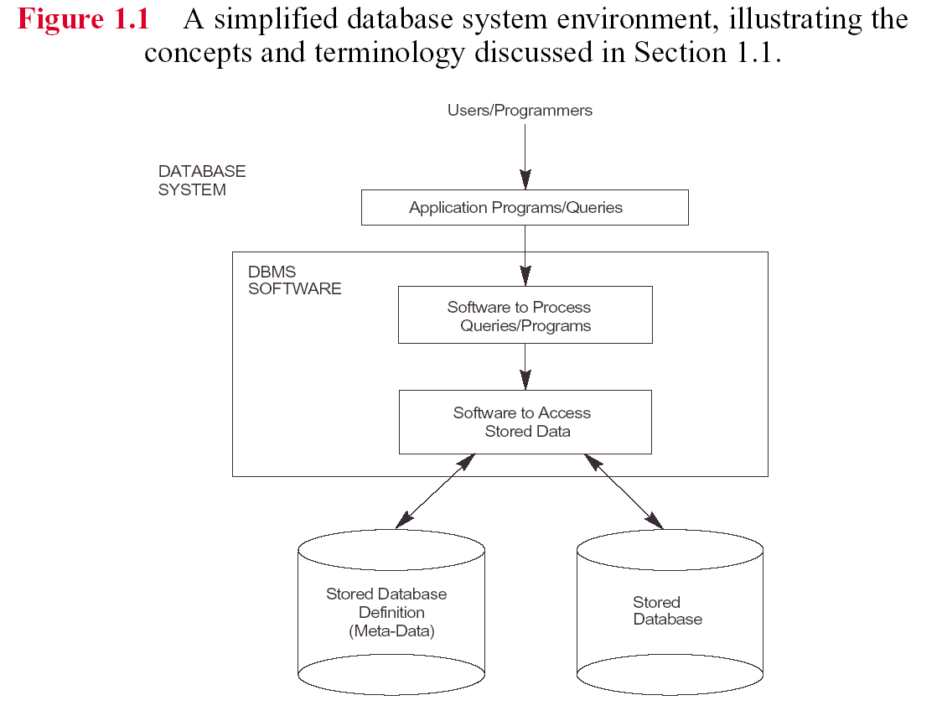

Slide 25
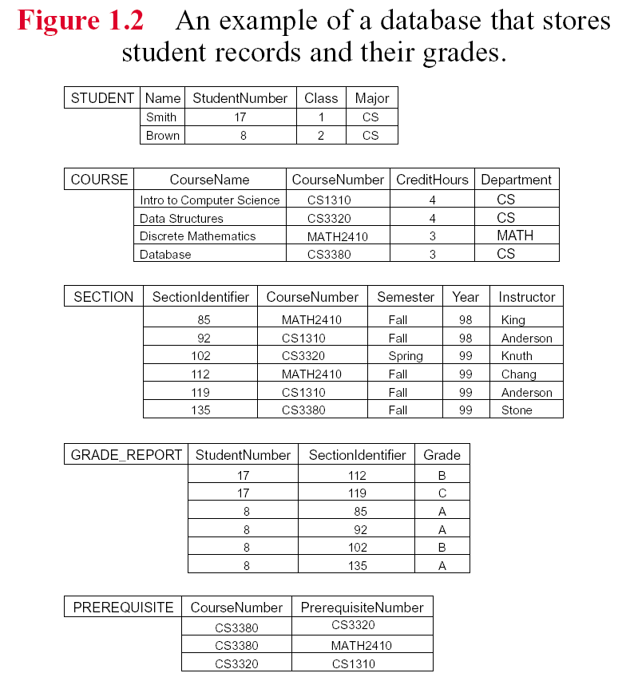

Slide 26
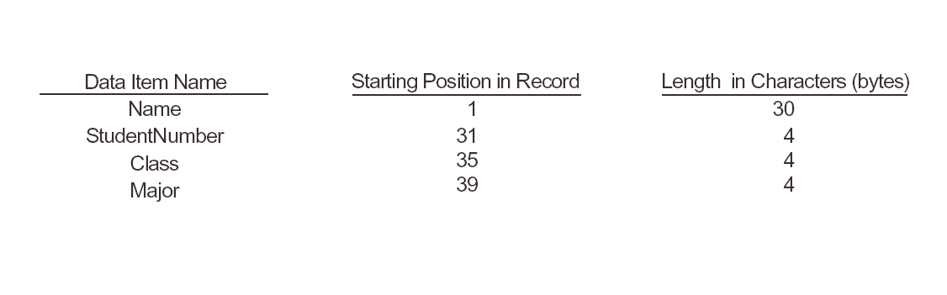

Slide 27
